Slide 1

HIRING PROCESS ANALYTICS
STATISTICS
By RASHMI WARIYAL

Slide 2
DESCRIPTION
Hiring process analytics involves using data to optimize recruitment efforts. It tracks and analyzes various stages of hiring, such as candidate sourcing, application volume, screening, and interviewing. Key metrics include time to hire, cost per hire, quality of hire, and candidate experience. Tools like Applicant Tracking Systems (ATS), predictive analytics, and machine learning help in optimizing processes, managing talent pipelines, and ensuring diversity. The main challenges are data privacy, bias, and integrating data from multiple sources. The benefits include better decision-making, improved candidate experience, and more efficient resource allocation.

Slide 3
APPROACH
The approach to a hiring process analytics project involves setting clear objectives, collecting and cleaning relevant data, and analyzing it to identify trends and inefficiencies. Insights from the analysis lead to actionable recommendations, which are implemented to optimize the hiring process. Continuous monitoring and reporting ensure the effectiveness of these changes, with ongoing iterations for improvement based on feedback and new data.

Slide 4
TECH-STACK USED
The primary tech-stack used in this project involves Excel. Excel offers a wide range of functions and tools for data analysis and data manipulation, making it ideal for task like exploratory data analysis and drawing insights from the dataset. Excel's features such as formulas, functions, pivot tables, charts, can be utilized for data cleaning, calculating statistics, identifying trends, and creating visual representation of hiring data, providing a user-friendly interface for analysis.

Slide 5
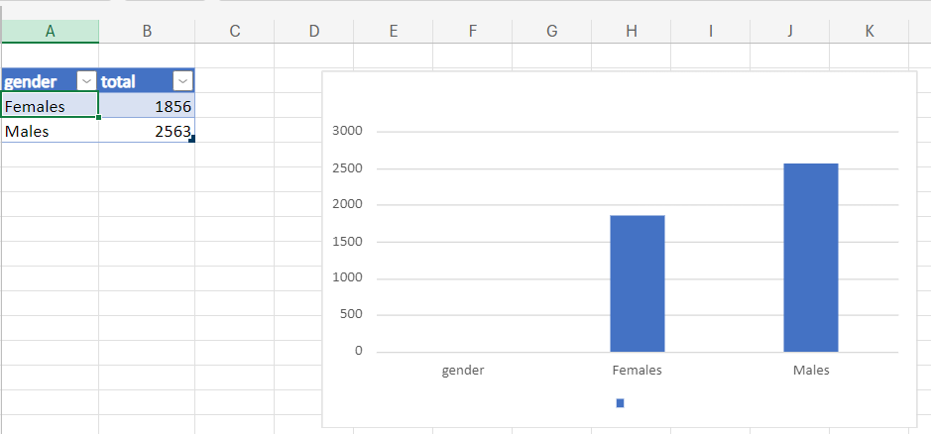
Task 1: How many males and females are hired?

Slide 6

TASK 2: What is the average salary offered in this company?

Slide 7
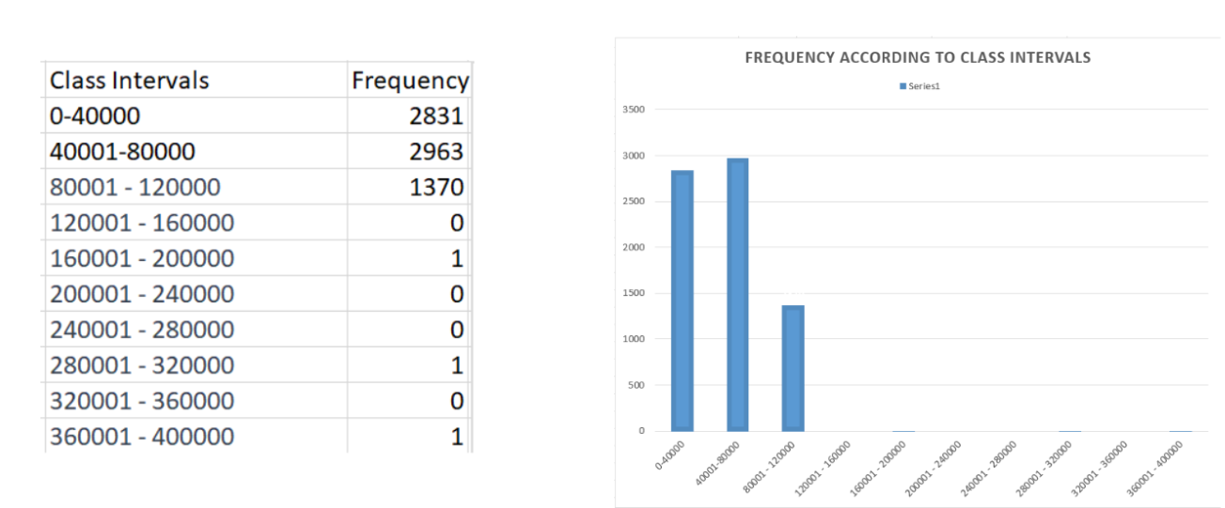
Task 3- Create class intervals for the salaries in the company.

Slide 8
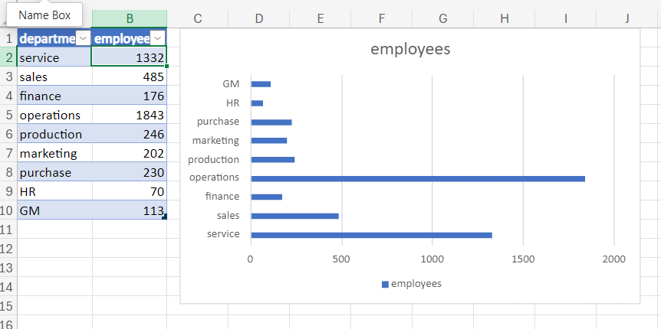
Task 4-Show the proportion of people working in different departments.

Slide 9
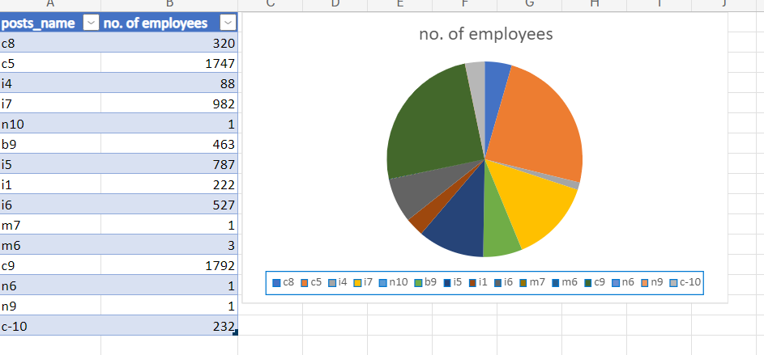
Task 5- Represent different post tiers.

Slide 10
RESULT
While working on this project, I have learned several things. I successfully analyzed the hiring data, identified the number of males and females hired, and calculated the average salary offered. Additionally, I created class intervals for salary ranges and visualized the data through charts and graphs to showcase departmental proportions and post tiers. This project has enhanced my skills in data analysis, statistical calculations, and data visualization techniques. It has also provided me with valuable experience in deriving insights from real-world datasets, further strengthening my capabilities as a Data Analyst.

Slide 11
THANK YOU

